Slide 1
Multimedia System and Virtual Environment
CSE – 310
Lecture 2
Introduction
Dept. of Computer Science and Engineering, University of Rajshahi

Slide 2
Introduction
Lecture 2
Key Properties of a Multimedia System
Data Transmission Characteristics
Characterizing Continuous Data Streams
Multimedia Advantages & Disadvantages
Dept. of Computer Science and Engineering, University of Rajshahi

Slide 3
Introduction
Lecture 2
Key Properties of a Multimedia System
Discrete and continuous media
Support of one type does not constitute multimedia
Independent media
The media used in a MM system should be independent.
Computer-controlled systems
We need a system capable of processing media in a computer-controlled way.
Integration
Independent media streams can be integrated to form a global system.
Dept. of Computer Science and Engineering, University of Rajshahi

Slide 4
Introduction
Lecture 2
Characterizing Data Streams
Distributed networked multimedia systems transmit continuous and discrete data
Data transmission characteristics:
Asynchronous
Synchronous
Isochronous
Dept. of Computer Science and Engineering, University of Rajshahi

Slide 5
Introduction
Lecture 2
Asynchronous Transmission
The sender and the receiver do not need to coordinate before data can be transmitted.
Two independent clocks (one at the sender and the other at the receiver) determine the start of each bit (bit synchronization)
Dept. of Computer Science and Engineering, University of Rajshahi

Slide 6
Introduction
Lecture 2
Synchronous Transmission
The beginning of transmission may only take place at well-defined times, matching a clocking signal that runs the synchronism with that of the receiver.
Dept. of Computer Science and Engineering, University of Rajshahi

Slide 7
Introduction
Lecture 2
Isochronous Transmission
The time interval separating any two corresponding transitions is equal to the unit interval or to a multiple of the unit interval.
Transmission rate “guaranteed” and jitter is minimized.
Significant instants of two or more sequential signals have a constant phase relationship.
Dept. of Computer Science and Engineering, University of Rajshahi

Slide 8
Introduction
Lecture 2
Characterizing Continuous Data Streams
This is in relation to audio and video transmission
Strongly and Weakly Periodic Data Streams
Variation of the data volume of consecutive information units.
Interrelationship of consecutive packets.
Dept. of Computer Science and Engineering, University of Rajshahi

Slide 9
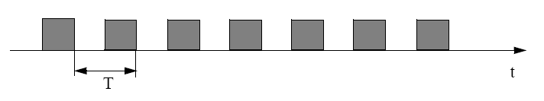
Introduction
Lecture 2
Strongly Periodic Data Stream
Constant time interval
Minimum jitter
e.g. PCM (Pulse-code modulation) encoded voice in telephone systems
Dept. of Computer Science and Engineering, University of Rajshahi

Slide 10
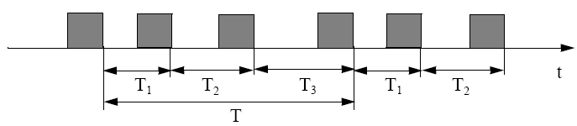
Introduction
Lecture 2
Weakly Periodic Data Stream
Duration of time intervals between neighboring packets is a function with finite period duration.
Time intervals between neighboring packets is not constant.
Dept. of Computer Science and Engineering, University of Rajshahi

Slide 11
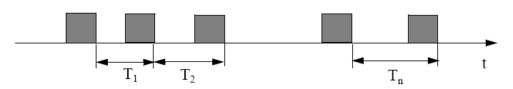
Introduction
Lecture 2
Non-Periodic Data Streams
Other possibilities
e.g. mouse movement on white boards of the screen in video conferences
Dept. of Computer Science and Engineering, University of Rajshahi

Slide 12
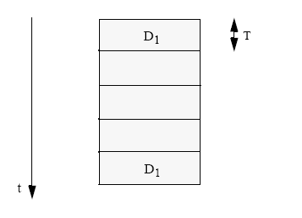
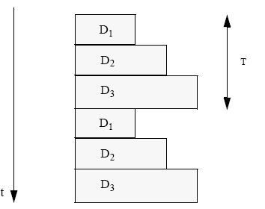
Introduction
Lecture 2
Variation of the Data Volume of Consecutive Information Units.
Strongly Regular
e.g. uncompressed
audio/video
Periodically Regular
e.g. MPEG
Dept. of Computer Science and Engineering, University of Rajshahi

Slide 13
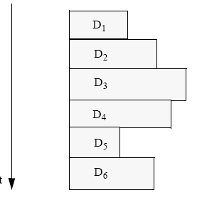
Introduction
Lecture 2
Variation of the Data Volume of Consecutive Information Units.
Irregular
e.g. JPEG
Dept. of Computer Science and Engineering, University of Rajshahi

Slide 14
Introduction
Lecture 2
Multimedia Advantages
Engrossing (interesting) – deep involvement
Multi-sensory
Creates knowledge connections
Individualized
Teacher and student creation
Dept. of Computer Science and Engineering, University of Rajshahi

Slide 15
Introduction
Lecture 2
Multimedia Disadvantages
“Lost in cyberspace”
Lack of structure
Non-interactive – if one-way, no feedback
Text intensive (serious) content
Complex to create
Time consuming
Dept. of Computer Science and Engineering, University of Rajshahi

Slide 16
Introduction
Lecture 2
jitter is the variation in the time between packets arriving, caused by network congestion, timing drift, or route changes.
Dept. of Computer Science and Engineering, University of Rajshahi

